Slide 1


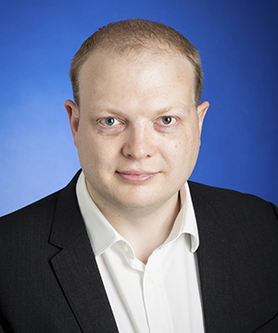
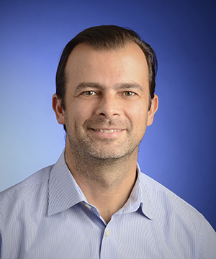
NEILL RIORDAN
COE lead D365 F&O
KPMG
Solution Architect V2.0 – A holistic view of core skills required to support D365 implementations
JOSE AZEVEDO
COE lead D365 BC
KPMG

Slide 2
Agenda
Pop-Up Quiz
Personal Intro
Solution Architecture – The Role & the challenge
Holistic View
Tips & Tricks
Q & A

Slide 3
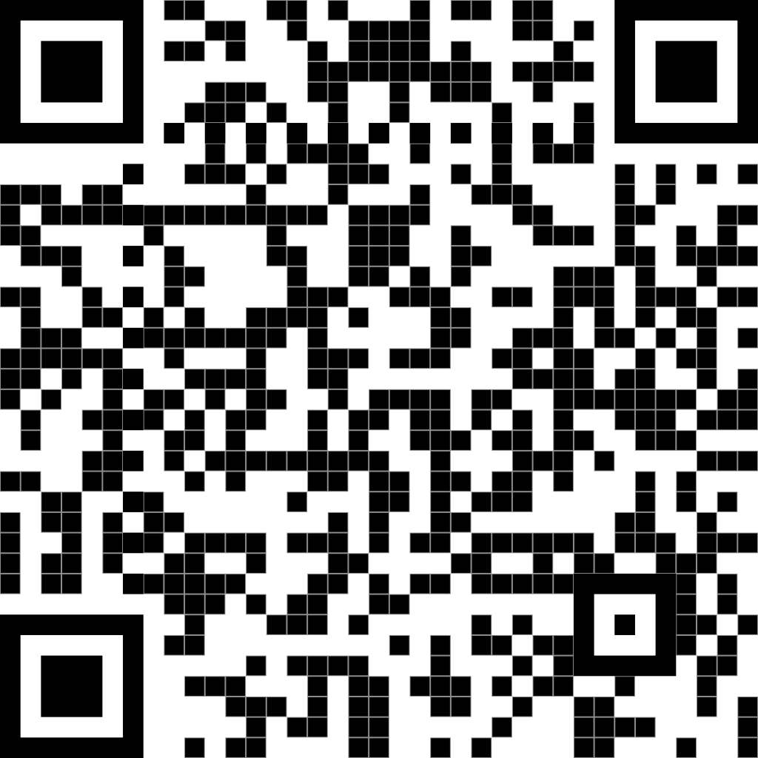
Pop-Up Quiz
Type of attendee
What is your Microsoft "home" product?
Involvement in Multi-Country project?
Focus in just one Industry?
Have you been a regular part of a C-suit steering committee for a program?
Involvement in Cross-Platform projects?
Involvement in projects Multi-Country, Multi-Industry and Multi-Platform
https://forms.office.com/e/gv82sJiKCa

Slide 4
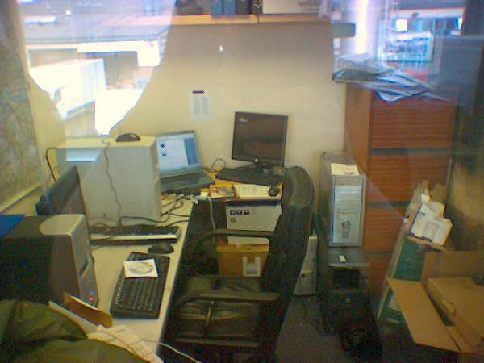
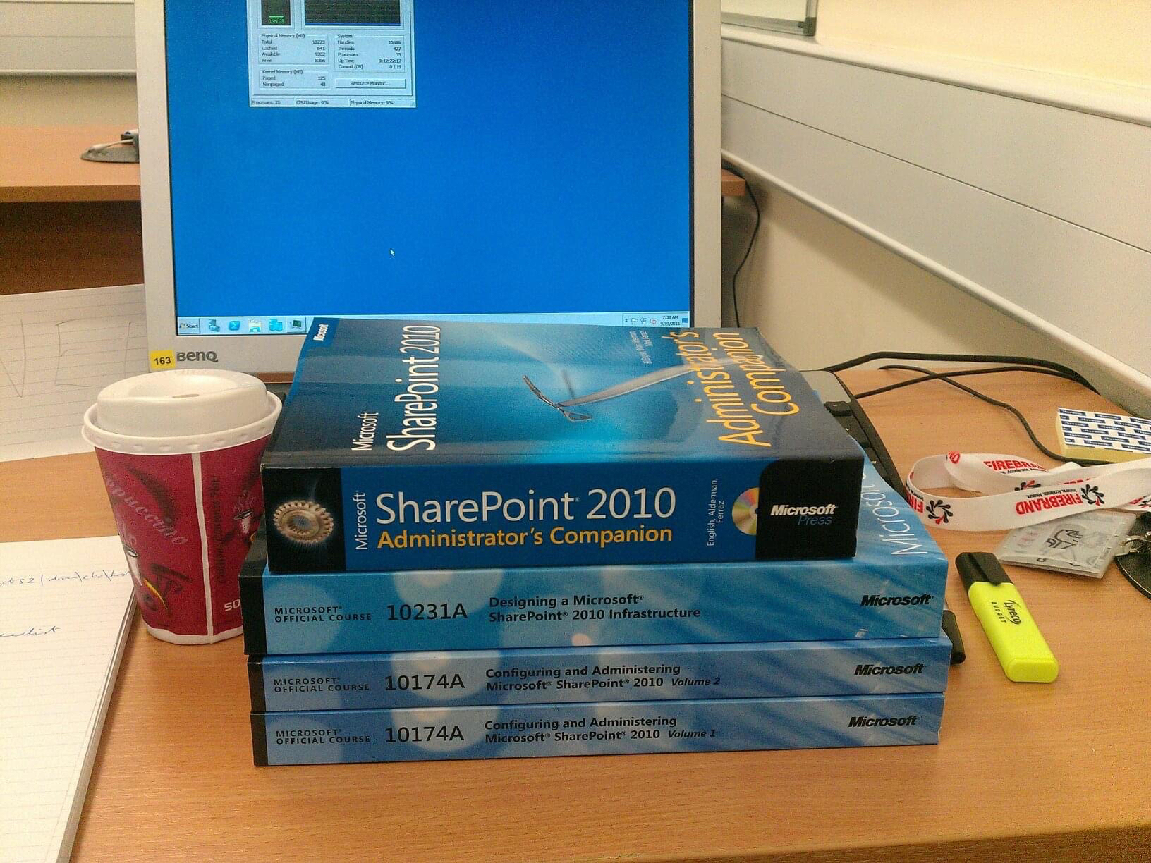

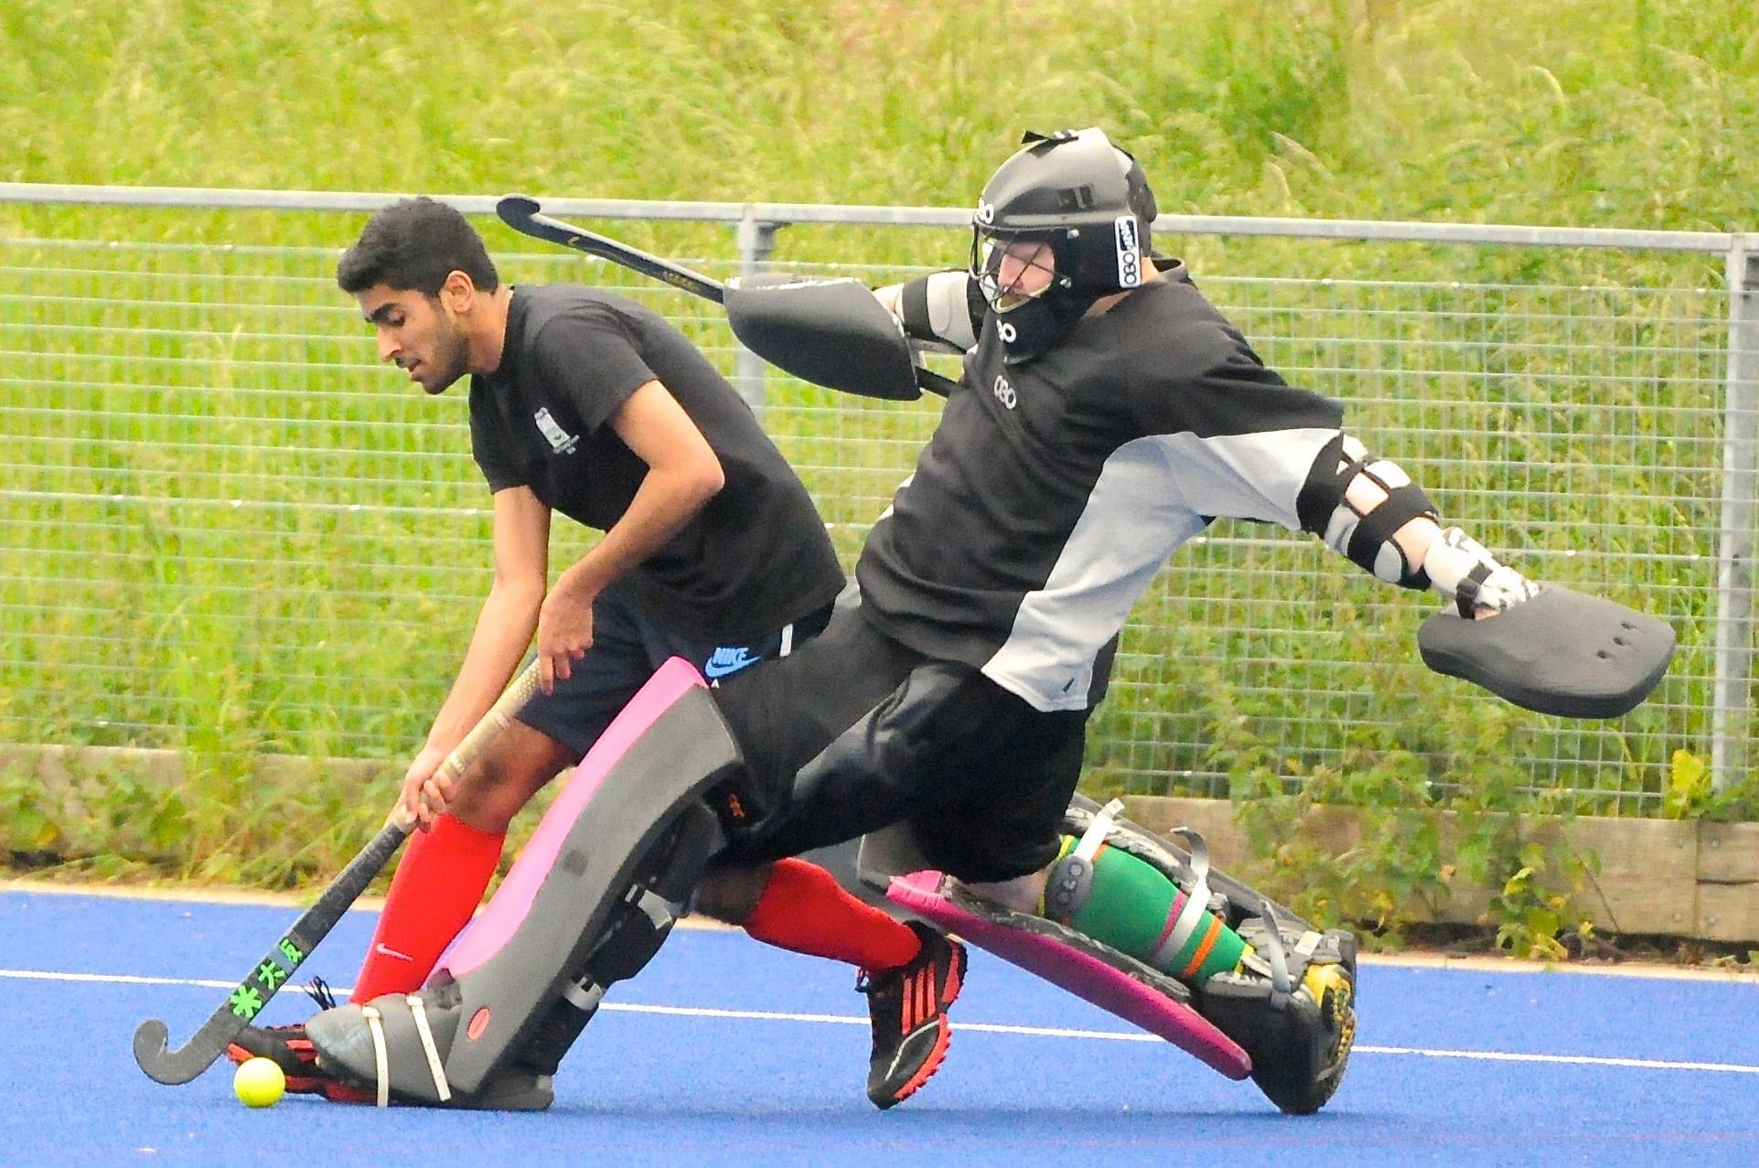

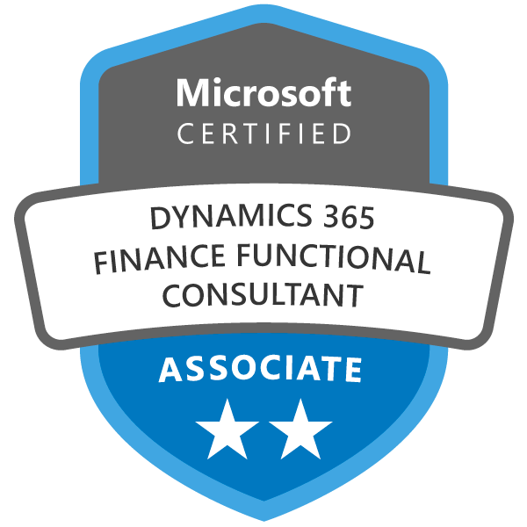
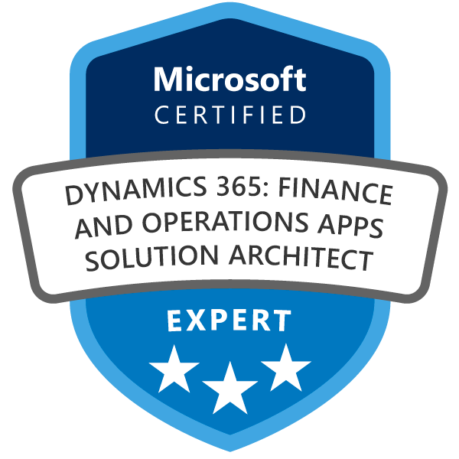
IT Manager
Solution Architect (KPMG)
AX Consultant
2000
2009-2012
2014- 2019
2005-2008
20122014
2021..
IT Guy
IT Project planner
Solution Architect (IBM)

Slide 5



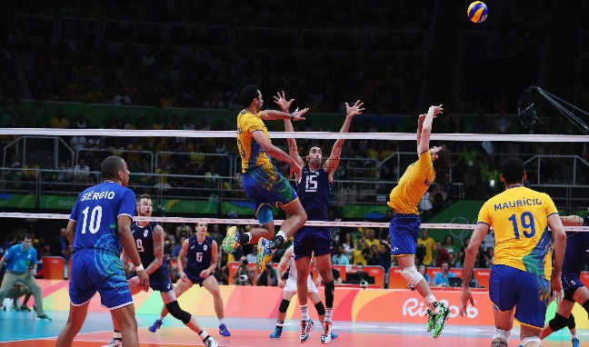













Functional Consultant
Project Manager
Programme Manager
Site Manager
Solution Architect
Blog Owner
Speaker
1997-98
2004-2009
2011-2018
1998-2004
2010-11
2018..
Business Consultant
Functional Consultant
Project Manager
Product Manager
University Teacher
+ 50

Slide 6
Solution Architecture – The Role & the challenge
Definition
“The solution owner of all Microsoft products in the project” MS Fast Track

Slide 7
Solution Architecture – The Role & the challenge
PM
TA
3-Way Tension
SA
Time and Quality
Scope and Solution
Approach and Mindset

Slide 8
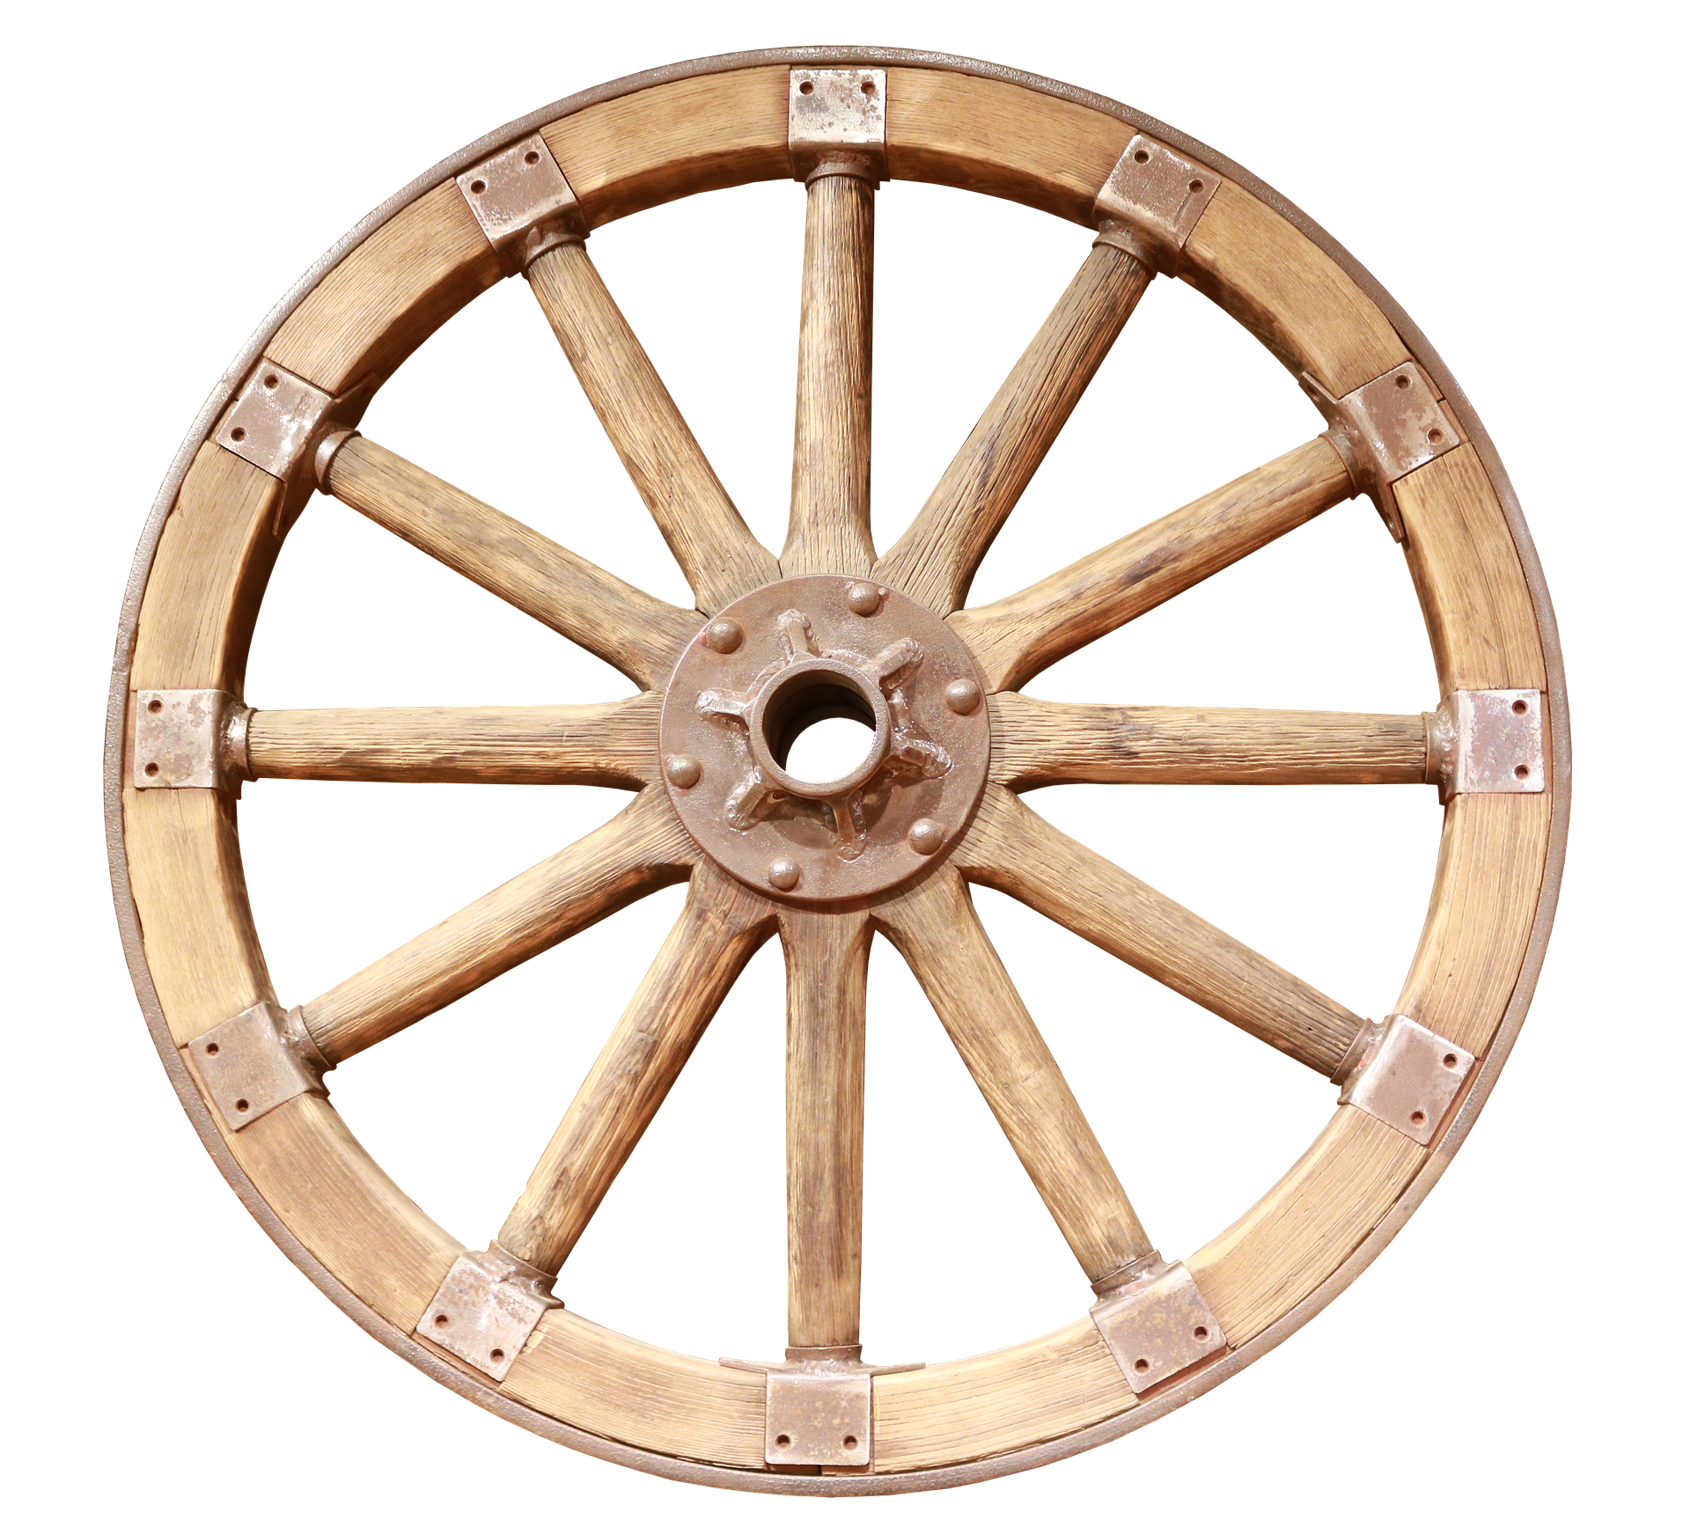
Solution Architecture – The Wheel

Slide 9
Solution Architecture – Holistic View
Industry
Technical
Fast-Track knowledge of our chosen industries
Retail, Local Gov’t, FFS
Azure components
Core application competence
Fit/Gap across the technologies (e.g.)SA from CE
Engagement & Team Skills
Functional
Leadership and Motivation skills
Collaboration
Presentation
Business awareness (e.g.) Org structures, finance (e.g.) Basic concepts
Common business terminology (e.g.) DOA
Solution Architect
Problem Solving
Method
Solving strategies
Problem solving tools & techniques
Method and approach
Tooling
Estimating
Stake Holder Management
Commercial
Trusted Advisor
C-Suit language and messages
Negotiation
Commercial awareness
Management of programme cost and change
Solution value

Slide 10
Solution Architecture – A practical example
UK based business
5 Business Units / 25 Fiscal Companies
Group with strong growth plan (Mainly by Acquisitions)
Different ERPs, CRMs and Other Legacy Solution
Core Finance, P2P and integration with Operational Systems
RFP after Assessment with 3rd Party expert – Dynamics 365 BC

Slide 11
Solution Architecture – A practical example

Slide 12
Solution Architecture – Tips & Tricks
Individual Survey – Holistic View - The wheel
Involve All Architects in Governance
Identify role models and mentors
Architecture Academy
Full cycle with Senior SAs
Promote Senior SAs to Coaches AA
Allow organic growth from resource pool
Turn this approach as a living approach

Slide 13
Q & A

Slide 14
Thank you for your attention!
Neill Riordan
neill.riordan@kpmg.co.uk
https://www.linkedin.com/in/neillriordan/
José Azevedo
maique00@gmail.com
https://www.linkedin.com/in/josemiguelazevedo/

